Slide 1
Results and analysis of the first parent questionnaire (Pirmojo tėvų klausimyno rezultatai ir analizė)
KINDERGARTEN OF KUZIAI „VYTURELIS“
2017

Slide 2
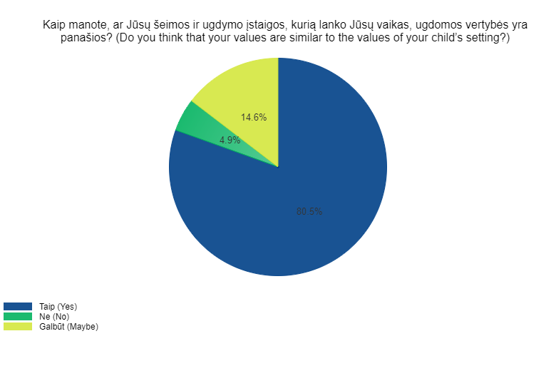
Do you think that your values are similar to the values of your child’s setting?

Slide 3
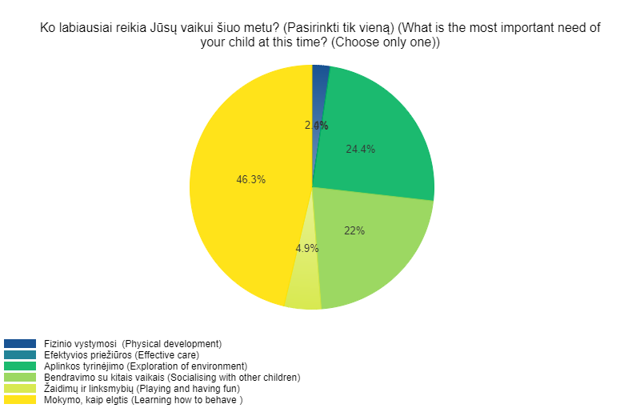
What is the most important need of your child at this time? (Choose only one)

Slide 4
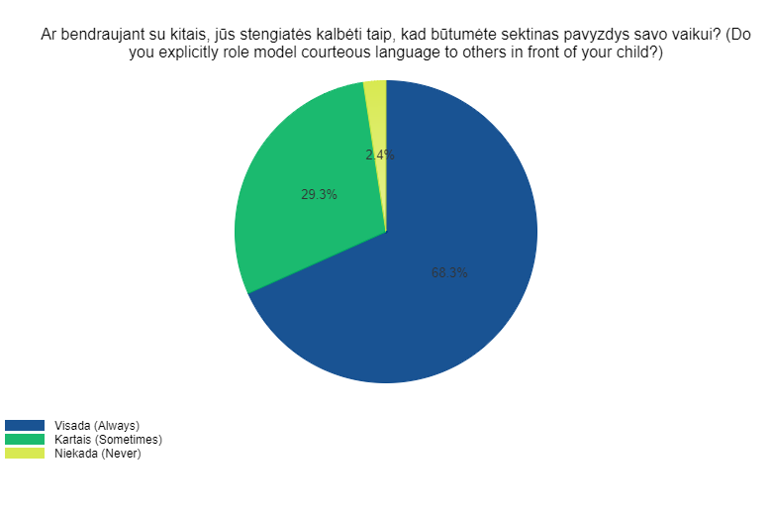
Do you explicitly role model courteous language to others in front of your child?

Slide 5
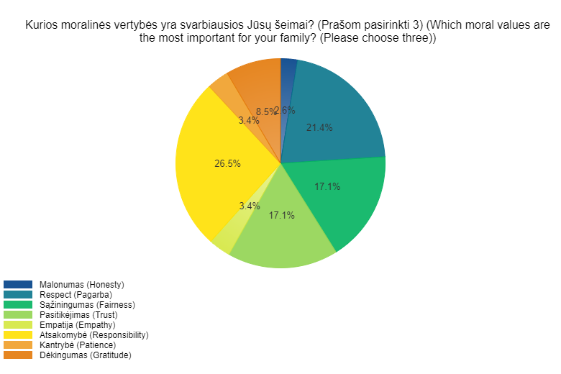
Which moral values are the most important for your family? (Please choose three)

Slide 6
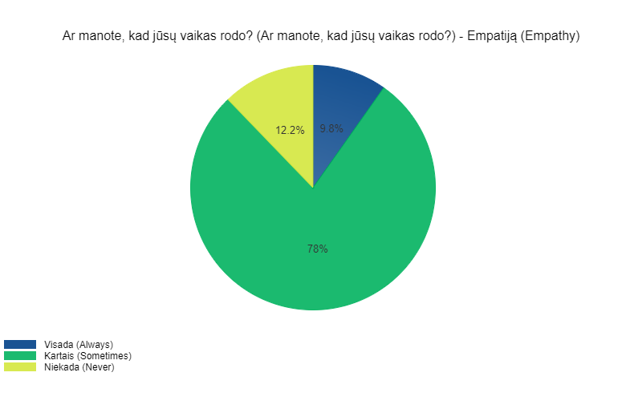
Do you think your child demonstrates: EMPATHY

Slide 7
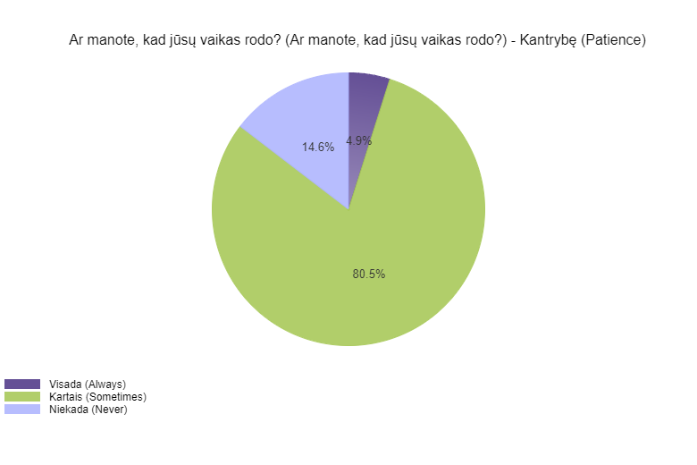
Do you think your child demonstrates: PATIENCE

Slide 8
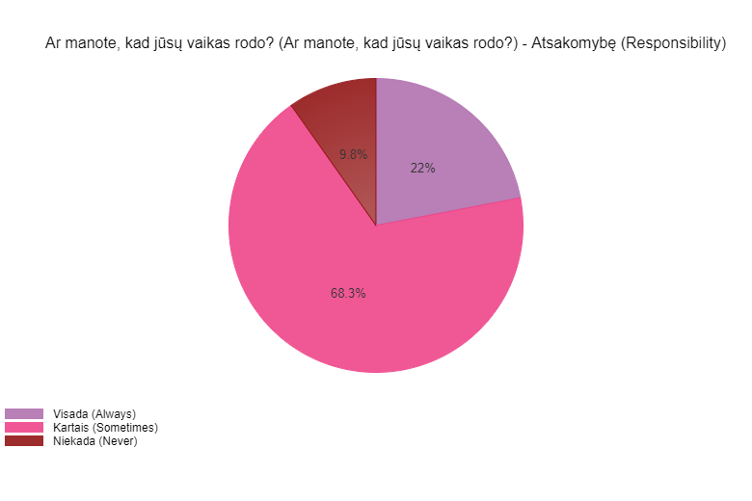
Do you think your child demonstrates: RESPONSIBILITY

Slide 9
END OF PRESENTATION THANK YOU FOR YOUR ATTENTION

